Slide 1
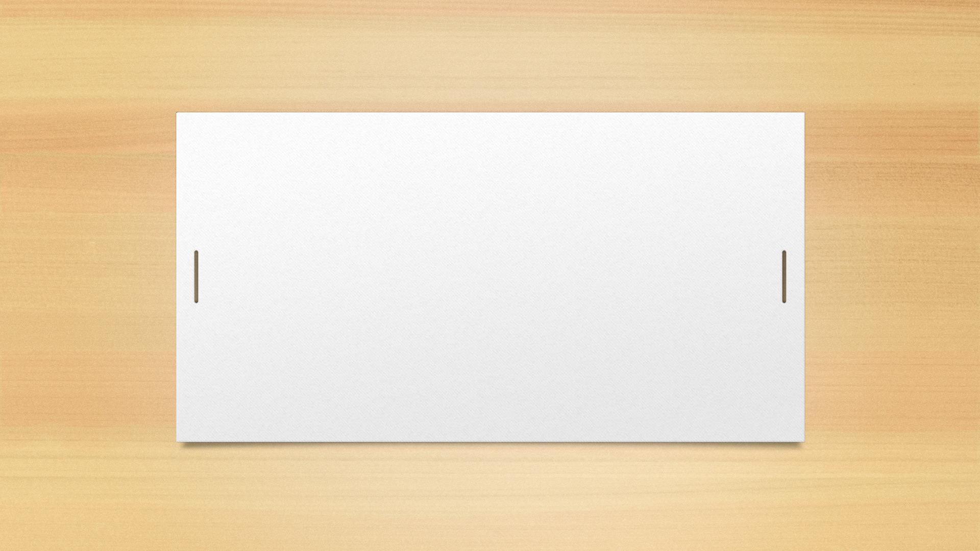


Representation of Data
CSE 1110 – Introduction to Computer Systems Course teacher: Saifur Rahman

Slide 2
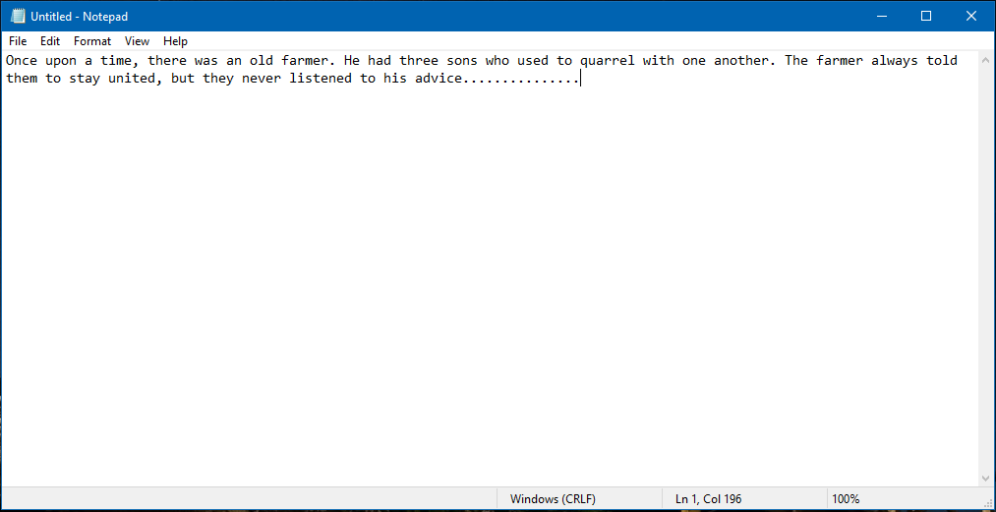

Text files
Or, texts

Slide 3
Text file
A text file is a collection of characters
Any symbol that can be written is called a character
Letters
Digits
Punctuation marks
Special characters
Whitespaces!
New lines!!
Even table borders!!!!

Slide 4
Representing characters in binary
Every character has its own unique binary code
When we write a text, the computer stores these binary codes in the exact order of our writing
Can we code the characters as we wish?

Slide 5
ASCII code
American Standard Code for Information Interchange
Used to represent English and Roman characters
Size: 7 bits
How many total characters?
Extended ASCII
8 bits
First 128 codes are same as ASCII
The remaining codes represent even more characters

Slide 6
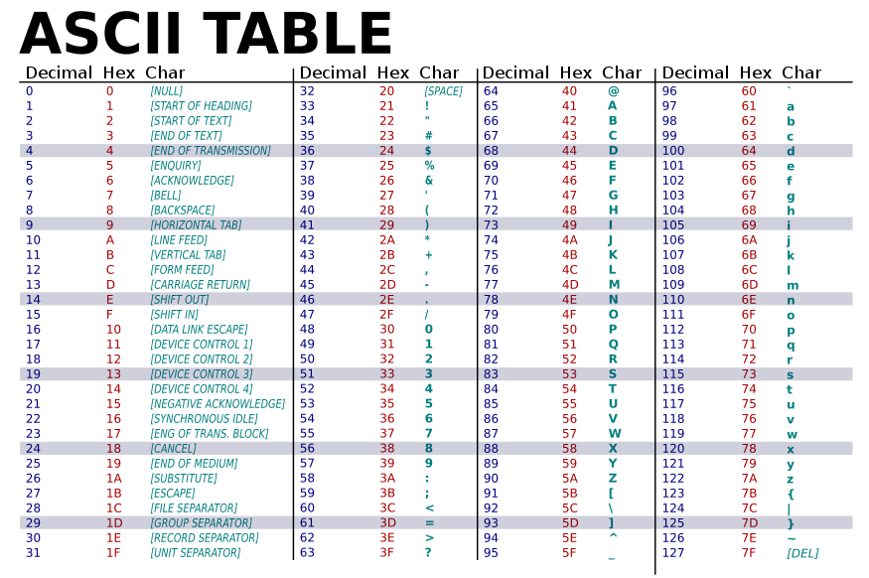

Slide 7
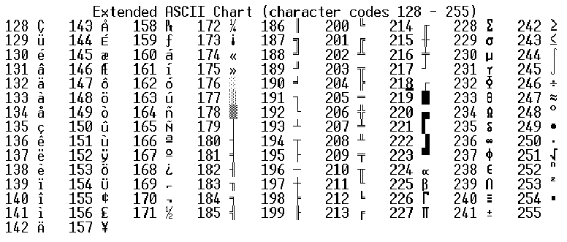
minhajul@cse.uiu.ac.bd
4/27/2022
7

Slide 8
Unicode
A standard code that contains characters from a vast variety of languages
Usually 1 to 6 bytes
Variable size!!!
Texts we see nowadays are usually Unicode
The first 256 characters are the same as ASCII
Backward compatibility

Slide 9
Once upon a time
O | n | c | e | _
01001111 | 01101110 | 01100011 | 01100101 | 00100000
u | p | o | n | _
01110101 | 01110000 | 01101111 | 01101110 | 00100000
 |  | a | _
01100001 |  | 00100000
t | i | m | e
01110100 | 01101001 | 01101101 | 01100101

Slide 10
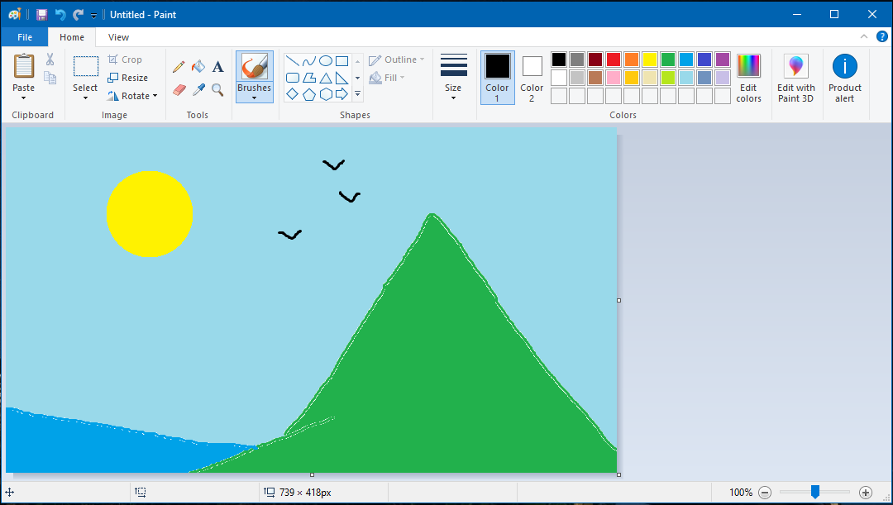
Images

Slide 11
How does a computer show its contents in a monitor?

Slide 12
Basic mechanism of monitor
A monitor contains a lot of small blocks named pixels (picture elements)
Each pixel is illuminated with some color
The pixels are so small that we cannot separate it from the others
How many pixels are there in the projector screen?
Hint: What is the resolution of the screen?

Slide 13
Drawing an image

Slide 14
How to represent color?

Slide 15
Coloring a pixel
Remember physics class?
Colors
Basic colors
How many basic colors?
Every pixel has three color components – Red, Green and Blue
1 byte space for each color – 3 bytes for each pixel
These colors are mixed to get all the colors
24 bit color scheme

Slide 16
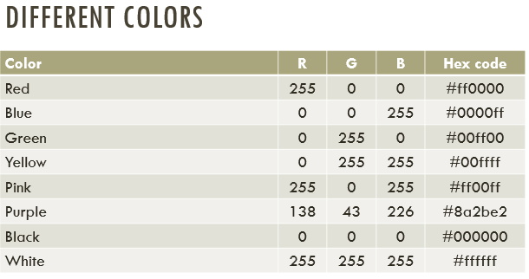

Slide 17
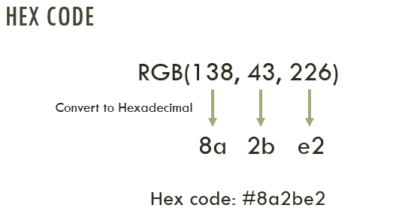

Slide 18



Size of an image file
Image file resolution: 24x10
File size = ?

Slide 19
Size of an image file
Image resolution = 24x10
Total number of pixels = 240
3 bytes for each pixel
Total size = 240x3 = 720B

Slide 20
Try yourself
What is the size of an image file of resolution 1000x800?

Slide 21
Try yourself
An image file contains the flag of Bangladesh. If its width is 1500 pixels, what is the size of the file?

Slide 22
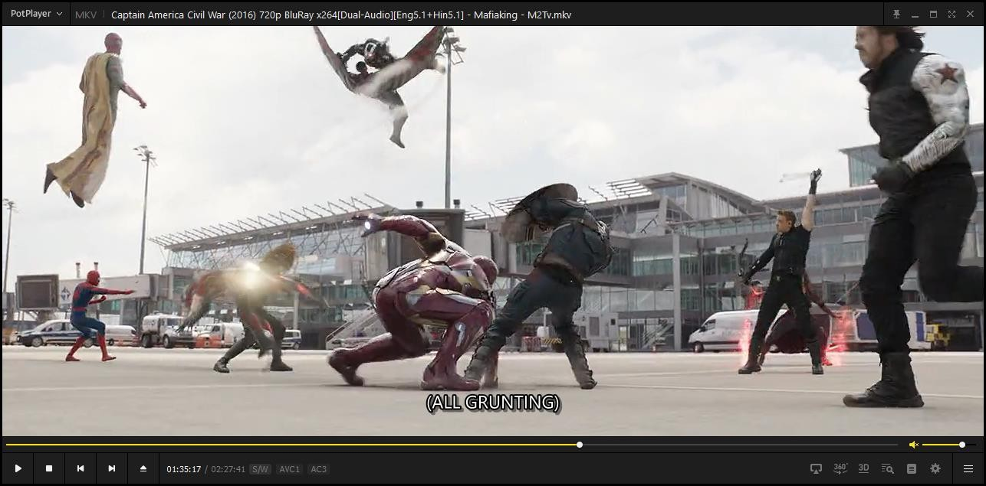
Videos

Slide 23
What is a video?
Video = Motion picture + audio
Motion picture = Lots of pictures
I mean really really a lot

Slide 24
Video file format
Every video contains a frame rate
Number of frames per second
A video with frame rate 24 fps contains 24 still pictures every second
Each picture size can be calculated as per previous slides

Slide 25
Example
A 15-minute video has resolution 1920x1080, and frame rate 24 fps
Size of each frame = 1920x1080x3 = 6220800 bytes
Total number of frames = (15x60)x24 = 21600
Total size = 6220800x21600 = 134369280000 bytes = 125.14 GB!!!!!

Slide 26
How come your 3-hour Avengers Endgame weighs only 4 GB?
Compression of images
Compression of changes in frames

